Slide 1


Poinsettia Fundraiser
A great way to raise funds
for your cause!
Christmas 2026
Warren Greenhouses Ltd.
warrengreenhouses@hotmail.com

Slide 2
Poinsettia Fundraising
A beautiful way to raise funds this holiday season!
How It Works
🌿 Choose a delivery or pick-up date between November 14th and December 13th.
🌿 Send us your sign-up sheet early to register. Time slots fill up quickly!
🌿 Start Selling! We require a 100 plant minimum to participate. (See FAQ for more info)
🌿 Use our summary form to submit your completed order no later than November 14th.
🌿 We'll bring your order to your chosen location, (or greenhouse pick up is available.)
🌿 We'll help unload, verify your order, and have you sign your invoice.
🌿 Your team members pick up from your select location.
Pricing at a Glance
Sizes
Your Cost
Suggested Selling Price
4.5"
$8 - $10
$4.50
6"
$7.75
$14 - $16
8"
$17.50
$26 - $30
10"
$24.50
$36 - $40
+ H.S.T. on all costs
💳 Invoice payment due within 30 days
✉️ Accepted: e-transfer, cheque, or cash
⚠️ Interest will be charged on all overdue accounts
Payment Details
115 Strange Street, Kitchener | 519-743-3702 | warrengreenhouses@hotmail.com

Slide 3
Important information and frequently asked questions.
Important!
Poinsettias are senstitive to cold and cannot be left in an unheated environment, (eg. unheated trunk or garage). They will freeze! They are packaged in a protective sleeve for transporting and that will need to be carefully removed within 24 hours. Be mindful of the branches, they can break!
What if I’m further than 60 km?
We can arrange pick up at the greenhouse, attempt to coordinate your delivery with someone in your area, and/or charge a delivery fee.
What if I don’t sell 100 plants?
We will still get you your order, but there will be a delivery fee included. Pick up options are available.
What if I need longer than November 14th to sell?
If you require a few extra days, we may run into the risk of colour substitution as poinsettias begin to sell quickly, but we’ll do our best to get what you need.
What if there is an issue with my poinsettia?
Our goal is to provide you with the best quality plants possible. Keep in mind they are a live plant and sometimes things happen! For any quality claims, please call us within 48 hours of your delivery. We’ll do our best to make it right!
Are poinsettias poisonous?
Nope! It’s a rotten myth. Although we don’t recommend ingestion, with excessive quanties there could be some digestion discomfort.
How do we pay?
Payment is due within 30 days of your invoice. We accept e-transfer, cheque, or cash. Our driver can accept payment. Please note that interest will be charged on overdue accounts.
115 Strange Street, Kitchener | 519-743-3702 | warrengreenhouses@hotmail.com

Slide 4

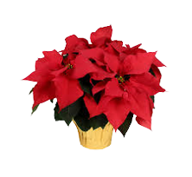
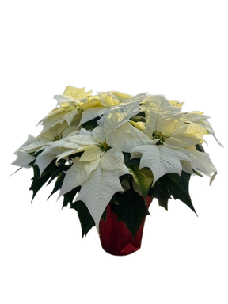
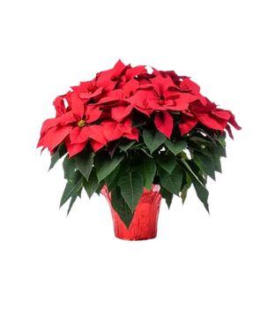
Choose Your Size
RED, WHITE or PINK available in all sizes (Colour shades will vary!)
Beautifully packaged in decorative pot covers
🌿 Care tip: Keep moderately moist, don’t let sit in water, keep in bright indirect light, and away from hot or cold drafts.
4.5" Poinsettia
Great for small areas, tables, desks centrepieces and bathrooms
6" Poinsettia
Great for tables, centrepieces, and anywhere that needs some decor!
Most popular
8" Poinsettia
Perfect for entrances, floors or large tables.
10" Poinsettia
A great statement in larger areas, entrances, large tables and floors

Slide 5
Christmas 2026
Fundraising Sign-Up Sheet
Group Name
Organizer Name
Delivery Date & Time
Delivery Address
City & Postal Code
Billing Address (if different)
City & Postal Code
Phone Number
Email
I __________________________, will be the contact person for the above-named organization and therefore will be responsible to having payment made by cheque, cash or e-transfer to Warren Greenhouses Ltd. within 30 Days. All late payments will receive 2% interest monthly.
Signature
Date
115 Strange Street, Kitchener N2G 1R4 | 519-743-3702 | warrengreenhouses@hotmail.com

Slide 6


Poinsettia Order Form
Team/Group:
Name:
NAME
4.5"
6"
8"
10"
TOTAL
OWING
R
W
P
R
W
P
R
W
P
R
W
P
R = Red | W = White | P = Pink
Cost: 4.5" $______ 6" $______ 8" $______ 10" $______
Warren Greenhouses Ltd. | 115 Strange Street, Kitchener | 519-743-3702

Slide 7
Please use this summary form to submit your completed order
4.5"
Qty
Qty
Red
Total 4.5"
White
Total 6"
Pink
Total 8"
Total 4.5"
Total 10"
6"
Total Poinsettias
Qty
Red
White
GROUP
Pink
Total 6"
CONTACT
8"
Qty
PHONE - CELL
Red
DELIVERY DATE
White
Pink
DELIVERY TIME
Total 8"
LOCATION
10"
Qty
Red
warrengreenhouses@hotmail.com
White
519-743-3702 telephone
519-743-0983 fax
Pink
Total 10"

